Slide 1

ADM-TECH
See the world through SMART Windows with a touch of a screen…

Slide 2
PITCH OUTLINE
ADM-TECH TEAM
INTRUDUCTION
DEMO
MARKITING
Q &A
END OF SESSION

Slide 3



ADM-TECH TEAM
Ali Ahmad Wali Zada (CEO)
Mohammadhadi Mobasseri (CTO)
Demas Ebhodaghe (CFO)

Slide 4
PROBLEMS
TRAVEL
FIND
DISCOVER
Travelling without proper guide is frustrating
Finding hidden places can be exhausting
Discovering information in a short time may not be possible

Slide 5
SOLUTION
A web platform where users plan their travel journey and enhance their travel experiences...
✓
Maximise
Leisure Time
✓
Reduce Travel Time
✓
Explore
New Places

Slide 6
Problem Validation

Slide 7
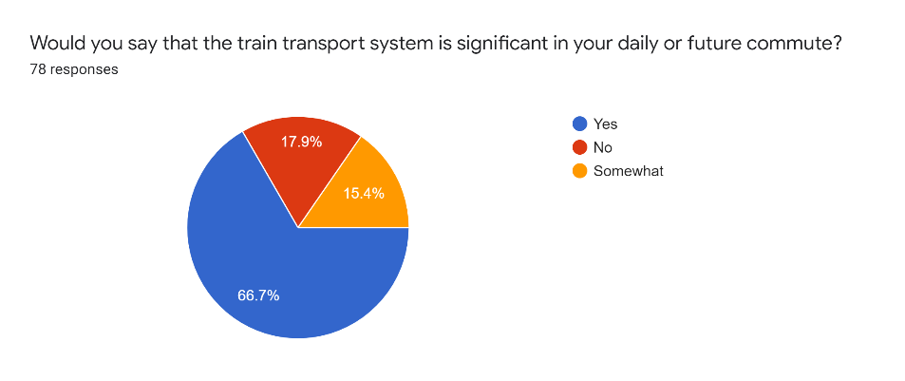
Problem Validation

Slide 8
Problem Validation

Slide 9
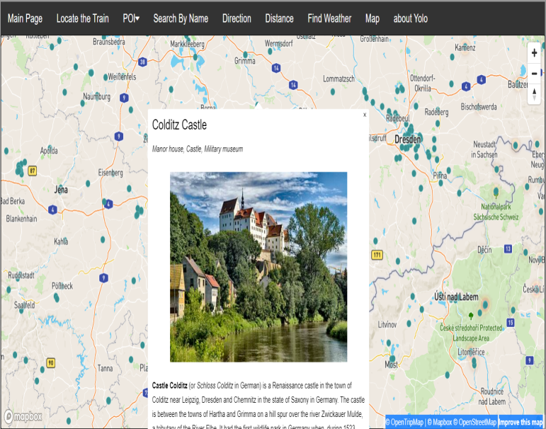
Product
POI Based On Map

Slide 10
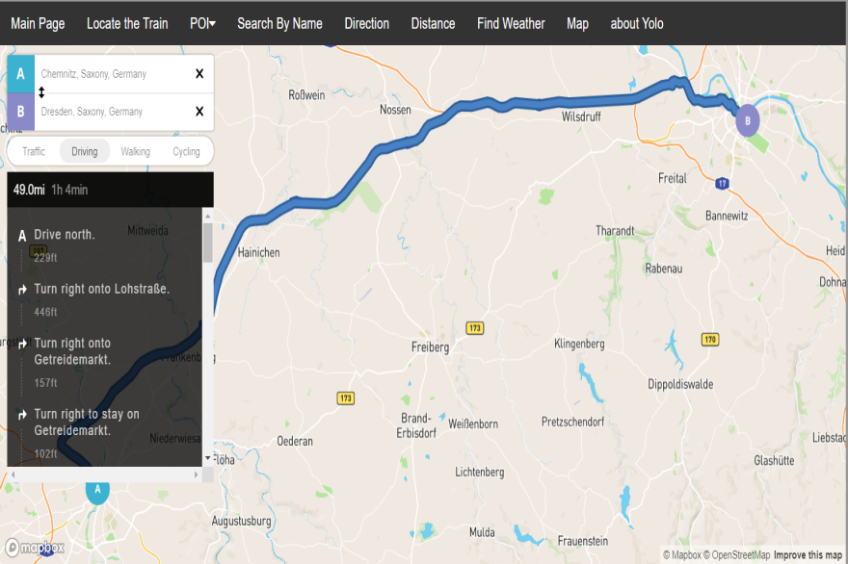
Product
Direction

Slide 11
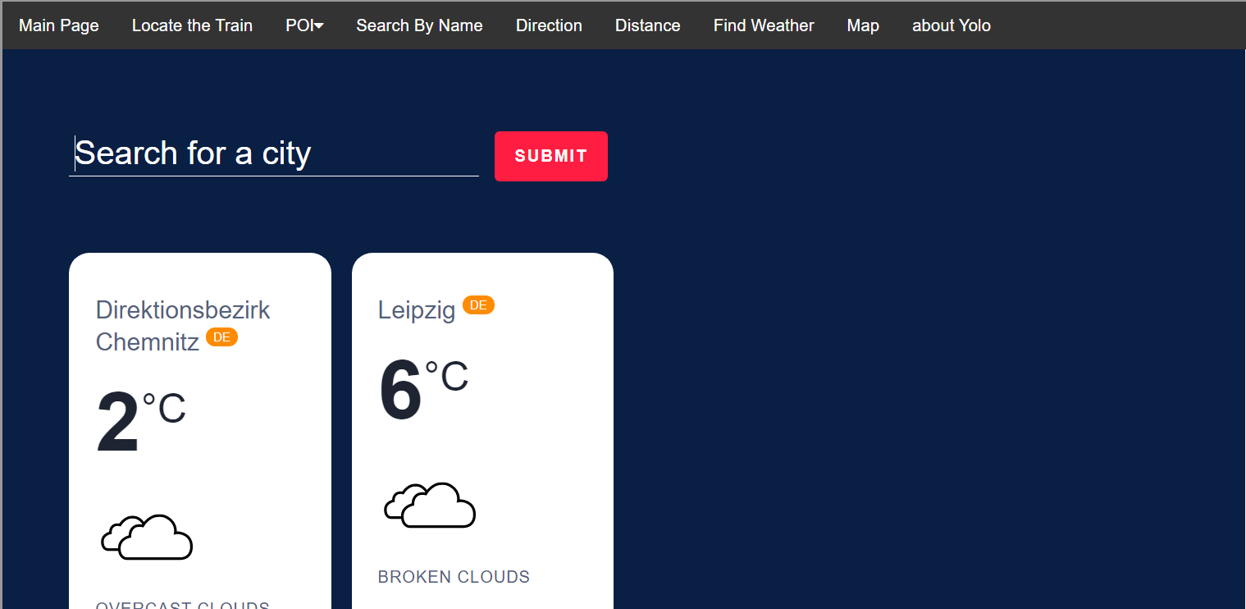
Product
Find Weather

Slide 12
Demo
https://www.adm-tech.de/v3/

Slide 13
Market Validation
8 BILLION Passengers…
travelled on national railway networks in the EU in 2018
2.8 BILLION Passengers…
travelled on national level in Germany 2018
Notes:
https://ec.europa.eu/eurostat/statistics-explained/pdfscache/1132.pdf

Slide 14
Marketing STrategies
✰Advertisements on Public Transport
✰Website/Social Media
✰Tourism Board Advertisements (Physical/Online)
✰Newspaper/
Online Articles
✰Word of Mouth From Users
✰Roadshows by The ADM Tech to introduce and promote the service

Slide 15
Competitive Advantage
NEWNESS
DESIGN
PERFORMANCE
ACCESSIBILITY
CUSTOMIZATION
CONVENIENCE

Slide 16
Business Model
Avg $5 → increase 10% = $5.5
$0.5 commision→20% = $0.1
32M/2 x $0.10 = $9,600,000
$1,600,000 x 10% = $160,000
$160,000
$0.10
32M Passengers Daily
Notes:
https://www.cleanenergywire.org/news/number-rail-passengers-germany-drops-40-percent-march

